Slide 1

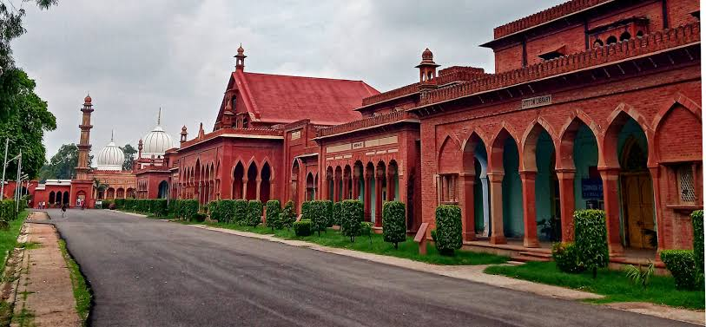
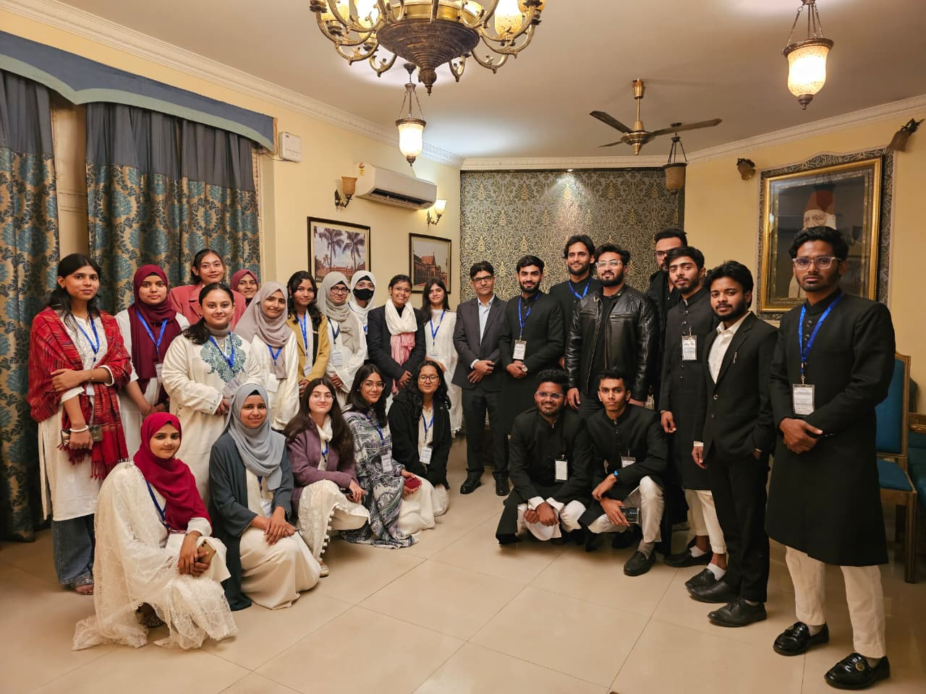
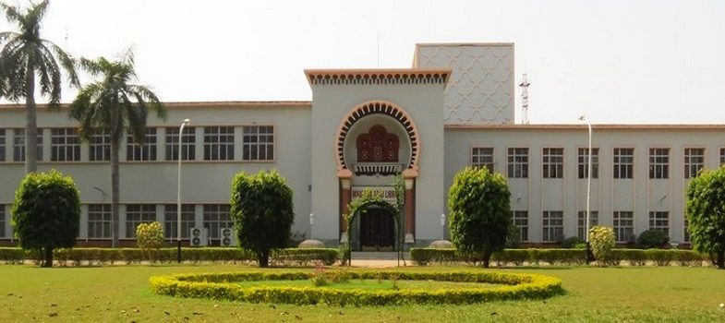
STUDENT MAGAZINE
VOL 1
AMU CAMPUS
“A Legacy of learning,
A culture of curiosity,
A vision for tomorrow.”
CAMPUS | CULTURE | FUTURE
August 2026

